Slide 1
SR Asia offers independent Assurance and Reporting services aligned with global standards such as BRSR, GRI, SASB, CDP, and IR. Our experienced team ensures credibility, transparency, and stakeholder confidence through third-party assurance. We support companies in sustainability data validation, ESG reporting, and value chain assessment. With over 150 assurance statements issued, we are among India’s leading licensed assurance providers. Partner with us to enhance your sustainability journey with accuracy, accountability, and impact.

Slide 2
Key Benefits of Assurance
Improved Transparency:
Enhanced credibility and trust with stakeholders through third-party verification of sustainability disclosures.
Regulatory Compliance:
Ensure alignment with SEBI’s BRSR requirements, reducing compliance risks.
Risk Mitigation:
Identify and address potential risks related to ESG performance, including environmental impacts and governance issues.
Global Standards Alignment:
Assurance ensures that company’s reports align with international standards like GRI, CDP, TCFD, and TNFD, enhancing global recognition.
Investor Confidence:
Strengthen investor confidence by providing robust, verified ESG data, which is increasingly a critical factor for investment decisions.
Sustainability Leadership:
Demonstrate leadership in sustainability and ESG reporting, contributing to improved reputation and market positioning.

Slide 3
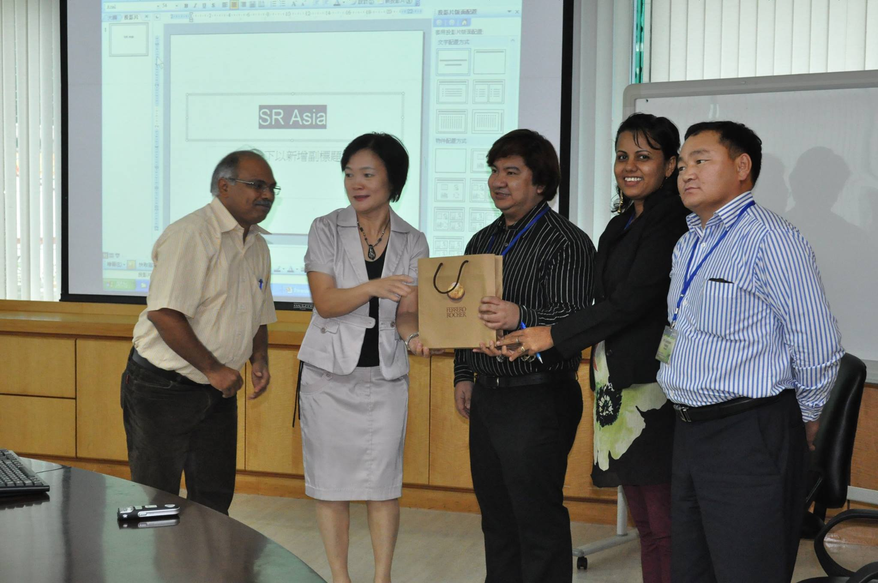

1. Corporate Profile-Reporting and Assurance Services

Slide 4


















Global Positioning and Brand Value
Value Propositions |  | Factors
 | Brand Recognition | Leadership in South Asia
 | Subject /Technical Expertise | Highly Qualified Multi sector Experienced
 | Market Competitive Cost | Use of Technology
 | National and Internal experience in Assurance | Presence in more than10 Countries
 | Assurance process transparency | Defined policy
 | Experience of handling large clients | Largest Govt and Private Clients in Asia
 | Compliance with Indian and International reporting guidelines | Licensed and Certified professional
 | Long-standing client relationships | High retention
 | Provision of Post assurance support | Policy Driven
International Presence
Bangladesh
India
Indonesia
Japan
Malaysia
Philippines
Singapore

Slide 5



















Expertise and Applications
BRSR-SEBI
Global Reporting framework and Standards
Technical Proposal Assurance Services – BRSR Core FY2025-26 for Emami Limited

Slide 6
Contextual References
Regulatory Requirement | Reporting Standards and Frameworks | Assurance Standards
Global Regulations and Guidelines India: Securities and Exchange Board of India (SEBI): Business Responsibility and Sustainability Reporting (BRSR) for the top 1000 listed companies by market capitalization. European Union (EU): Corporate Sustainability Reporting Directive (CSRD) EU Taxonomy Regulation Non-Financial Reporting Directive (NFRD) United States:SEC’s proposed rules on climate-related disclosures (under Regulation S-K) China: Environmental Information Disclosure Regulations. Australia: National Greenhouse and Energy Reporting (NGER) Act. Sector-Specific Requirements Energy Sector: Compliance with ISO 14001, IFC Performance Standards, and Equator Principles. Financial Sector: Adoption of the Principles for Responsible Banking (PRB) and the TCFD (Task Force on Climate-Related Financial Disclosures). Local Environmental Regulations Compliance with Environment Protection Acts (specific to each country). Adherence to Climate Change Acts or policies. | Global Reporting Initiative (GRI): Universal framework for sustainability reporting. Sustainability Accounting Standards Board (SASB): Industry-specific disclosure standards. Task Force on Climate-Related Financial Disclosures (TCFD): Climate-related financial disclosures. Carbon Disclosure Project (CDP): Voluntary environmental impact reporting. Integrated Reporting Framework (IR): Reporting on value creation over time. World Economic Forum (WEF) Metrics: Stakeholder capitalism principles. United Nations Global Compact (UNGC): Adherence to ten principles in human rights, labour, environment, and anti-corruption. | Assurance Standards Standard on Sustainability Assurance Engagements (SSAE) 3000 ISAE 3000 (Revised): Standard for assurance engagements on non-financial information. AA1000AS v3: Assurance standard for accountability and sustainability performance. ISO Standards: ISO 14064: Greenhouse Gas (GHG) accounting and verification. ISO 26000: Social responsibility guidelines. ICAEW Framework for Assurance: For the evaluation of non-financial information.
Technical Proposal Assurance Services – BRSR Core FY2025-26 for Emami Limited

Slide 7








Key Clients for Assurance Services

Slide 8
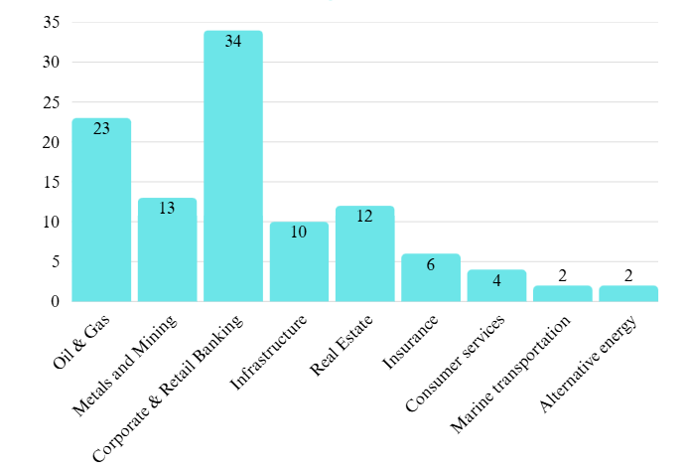
Sector Specific Experience

Slide 9
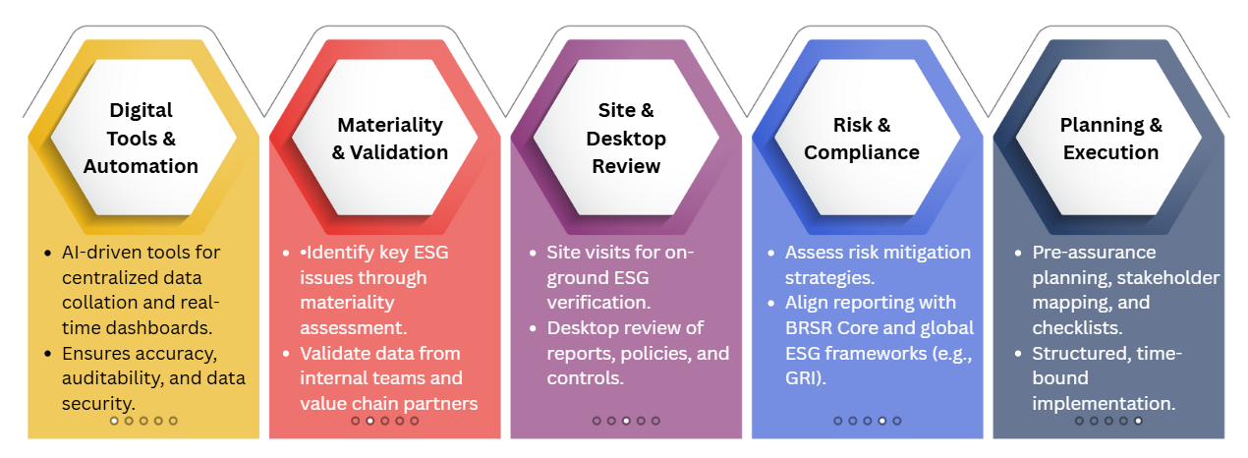
Assurance Approach

Slide 10


Step 1: Pre-Visit
Assurance Methodology
a. Document Review
b. Team Preparation
Assign Roles: Define the roles and responsibilities of each team member.
c. Checklist Preparation
Previous Reports: Examine past BRSR and sustainability reports, IR, audit reports, and internal assessments.
d. Stakeholder Map
Stakeholder List: Prepare a list of key stakeholders and contact persons at the corporate office and field sites.
ESG Data
Policies and Procedures: Gather and review all relevant policies, procedures, and guidelines related to sustainability, ethics, human rights, environmental management, and safety.

Slide 11
On-Site Assessment: Field Sites
Step 2: On-Site Assessment
a. Opening Meeting
b. Facility Tour
Operational Processes: Tour the facility to observe operational processes and environmental management practices. Safety Protocols: Check the implementation of health and safety protocols.
c. Interviews and Observations
Site Management:Interview managers and key staff on operations, safety, and environment. Employees & Contractors:Discuss experiences and check compliance with labour and safety practices.
d. Data and
Records Verification
Operational Data: Review emissions, waste, and resource use against internal records. Safety Records: Verify incident logs, training records, and safety compliance.
Introduction and Purpose: Introduce the assurance team and explain the purpose of the visit. Site-Specific Agenda: Outline the agenda tailored for the specific site.

Slide 12
Post-Visit Activities
Step 3: Post-Visit
a. Data Analysis
Consolidate Findings: Gather and analyse all data and information collected during the site visits.
Cross-Check: Ensure consistency between the data reported and the findings from the site visits.
b. Report Preparation
Draft Report: Prepare a draft assurance report outlining the methodology, findings, and any discrepancies.
Recommendations: Include recommendations for improvements based on best practices and observations.
c. Closing Meeting
Presentation of Findings: Present the preliminary findings to management.
Feedback: Obtain feedback and clarify any queries from the management team.
d. Final Report
Incorporate Feedback: Update the report based on feedback from the closing meeting.
Submission: Submit the final assurance report to management and relevant stakeholders.

Slide 13
WHY SR Asia?
Qualified, experienced founders Certified by APO on Green Productivity and Social Responsibility
Project executed for APO/NPO (1- India, 6- Bangladesh, 1- Indonesia)
Expertise of working in Europe and South Asia
Experts have working experience with large multinational organisations
Experts are qualified assurer from GRI and Accountability UK
We have already worked for more than 300 assurances based out of Singapore, Malaysia, Indonesia and India
Combined manpower SR Asia group employees (Permanent: 30, Rolling basis: 50)
Submitted Application to list SR Asia at Social Stock Exchange at NSE and BSE India
SR Asia presence in 06 countries (Bangladesh, India, Indonesia, Malaysia, Philippines and Vietnam)
Member of Confederation of Indian Industry (CII), UN Global Compact (UNGC)
Our focus areas are ESG, Climatic Change, Carbon footprint, GHG accounting advisory, research and assurance
We have provided assurance services for sectors such as Banking, Oil and Gas, Mining and metal, Energy , Infrastructure etc10
Type of reports covered are Sustainability reporting, Integrated reporting, BRSR, Value Chain partners, CDP, TCFD IFR-1 and 2, TNFD etc
MoU with IIT Madras COE division and Many universities
ISO 9001: 2015 Certified

